Slide 1
Comparative Analysis of Machine Learning Models for Housing Price Index Prediction
Jonathan J. Penaloza Rumie
Advisor- Dr. Sayani Sarkar

Slide 2
Outline
Project Overview
Exploratory Data Analysis
Methods / Modeling
Preliminary Results
Final Results
Conclusion/Future Work
Reflection

Slide 3
Project Overview
Develop accurate ML models to forecast housing price trends, identifying key drivers of market dynamics.
Federal Housing Finance Agency (FHFA) HPI dataset.
Features:
Temporal (year, period)
Geographic (place_name, region, place_id)
Methodological (hpi_type, hpi_flavor)

Slide 4
What is Index NSA
Measures raw data without adjusting for predictable seasonal patterns (e.g., weather, holidays, school calendars).
Examples:
Housing Price Index (HPI) NSA: Reflects actual monthly prices, including seasonal spikes (e.g., higher demand in spring).
Consumer Price Index (CPI) NSA: Shows inflation changes including holiday-driven price hikes (e.g., December retail surges).
Employment Index NSA: Reports job numbers with seasonal hiring spikes (e.g., summer tourism jobs).
Notes:
Short-term analysis: To observe true month-to-month changes.

Slide 5
Preprocess
For this project I had to eliminate a lot of rows that were not necessary or were just making up space
Index SA was not as concurrent as Index NSA
The data was very specific with the addresses of the houses sold

Slide 6
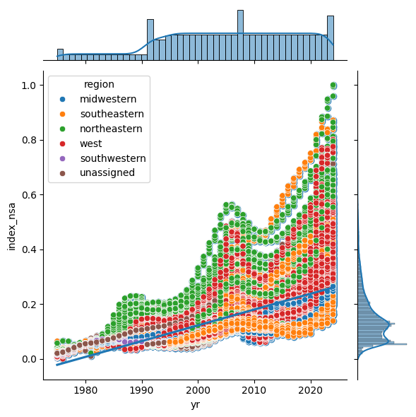
Exploratory Data Analysis

Slide 7
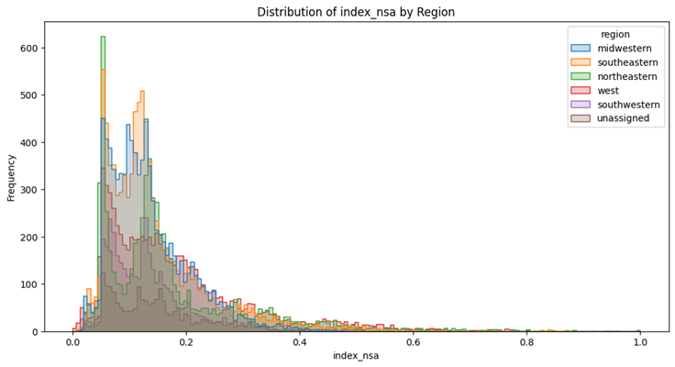
Distribution of Index NSA by Region

Slide 8
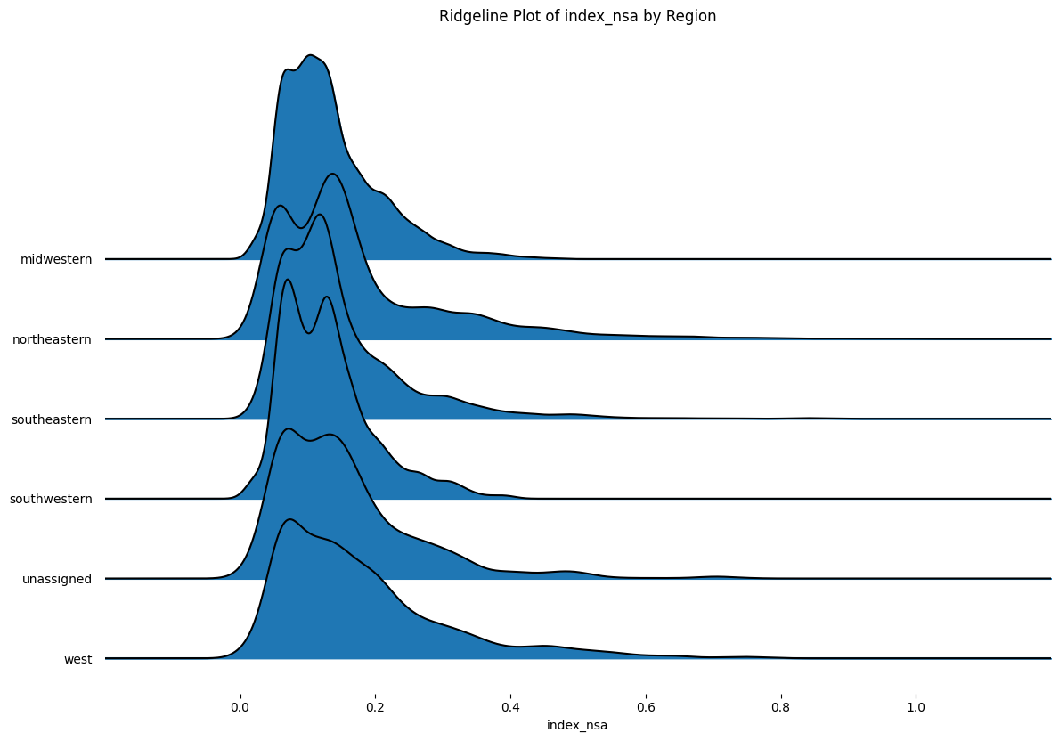
Distribution of Index NSA by Region

Slide 9
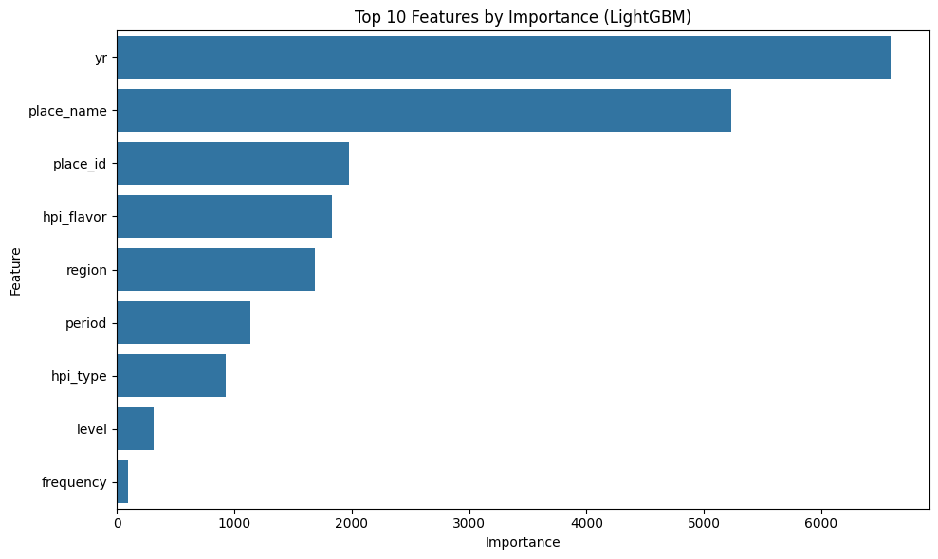
Feature Importance

Slide 10
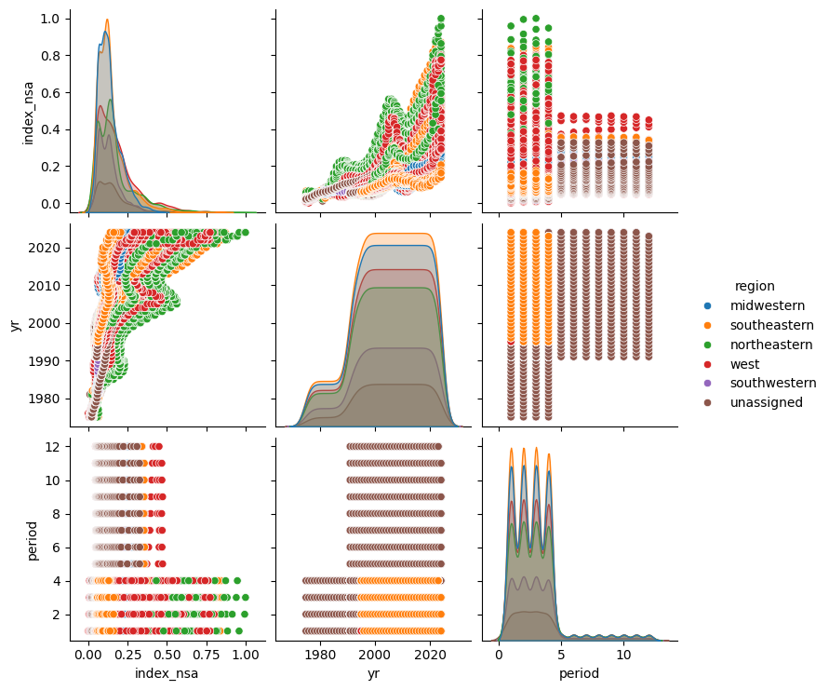
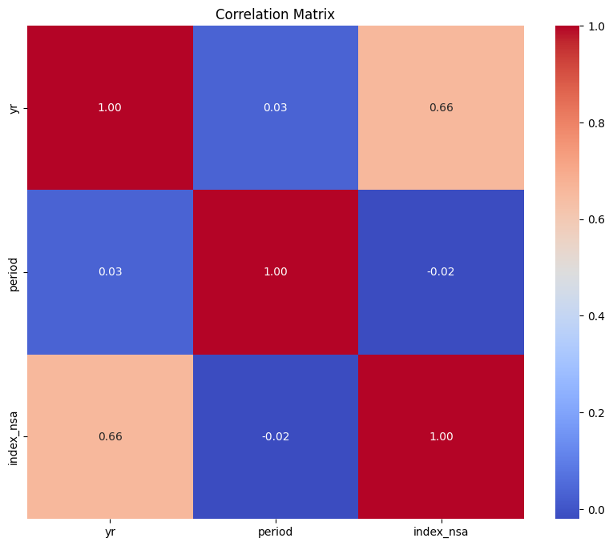
Correlation and Regional Trends

Slide 11
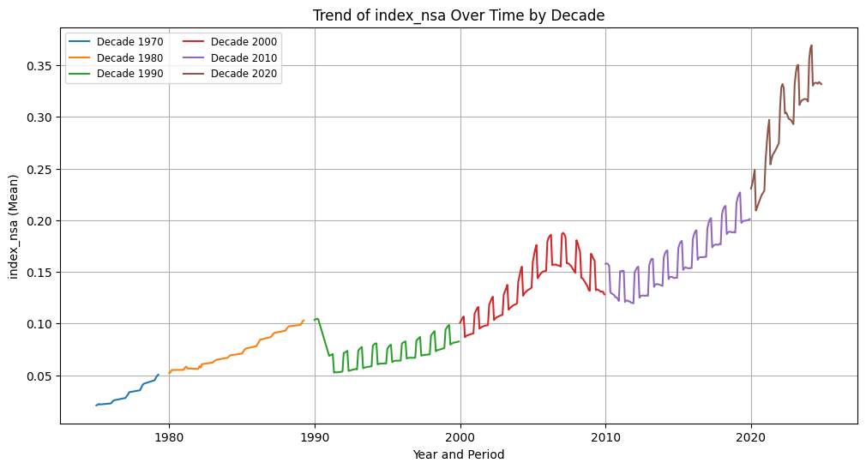
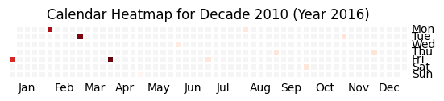
Trend of index NSA over time

Slide 12
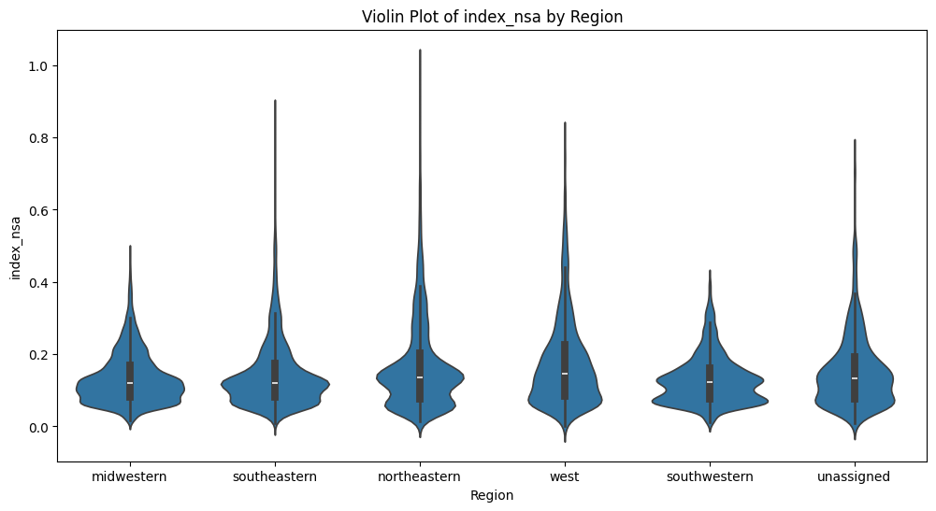
Distribution analysis

Slide 13
Methods & Modeling
Model | Key Hyperparameters | Notes
Linear Regression | Default parameters | Baseline linear model without regularization
Ridge Regression | Default alpha | L2 regularization applied
Lasso Regression | Alpha tuned via GridSearchCV: [0.001, 0.01, 0.1, 1, 10] | L1 regularization with hyperparameter tuning
Elastic Net | Default parameters | Combination of L1 and L2 regularization
Support Vector Regression (SVR) | Default kernel (RBF), default C and epsilon values | No explicit hyperparameter tuning performed
K-Nearest Neighbors (KNN) | n_neighbors=5, Minkowski distance metric (p=2) | Fixed number of neighbors
Random Forest | n_estimators=900, max_depth=20, min_samples_split=10, bootstrap=True, random_state=42 | Tuned for depth and number of trees
Gradient Boosting | n_estimators=100, random_state=42 | Default learning rate and depth
XGBoost | learning_rate=0.1, n_estimators=200, min_child_weight=2, subsample=1, colsample_bytree=0.8, reg_lambda=0.45, reg_alpha=0, gamma=0.5, random_state=42 | Tuned for regularization and tree parameters
LightGBM | Tuned via GridSearchCV: learning_rate=0.2, n_estimators=200, num_leaves=100, max_depth=-1, min_child_samples=20 | Best parameters found through hyperparameter tuning

Slide 14
Evaluation Metrics
Used of Google Colab and T4 GPU for model training​
R^2: Measures the percentage of variance in housing prices explained by the model
MSE (Mean Squared Error): Average squared difference between predicted and actual prices
Notes:
R^2 gives the explanatory power of the model
MSE tells us the accuracy of the predictions

Slide 15
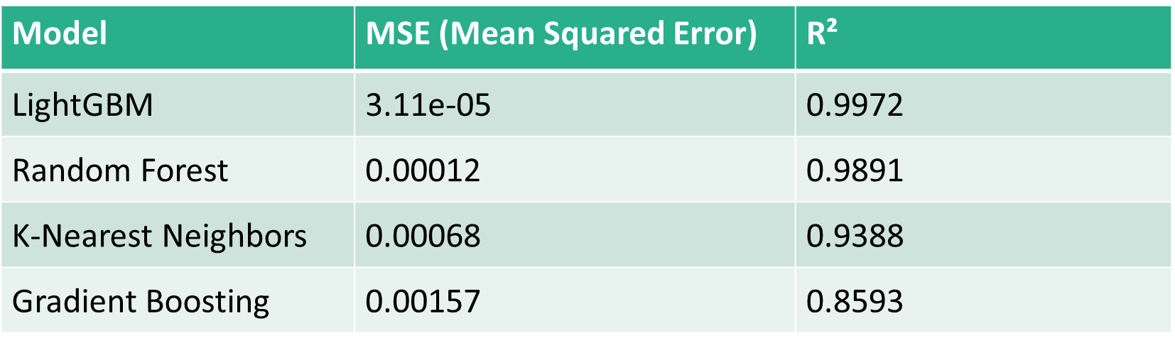
Preliminary results
Underperformers:
Lasso/Elastic Net (R² < 0)
Linear Regression (R² ≈ 0.607)
Ensemble models outperform linear approaches.

Slide 16
Hyperparameter Tuning
Grid Search: Exhaustively tests predefined hyperparameter combinations
(e.g., GridSearchCV in scikit-learn).
Bayesian Optimization: Efficiently explores parameter space using probabilistic models (e.g., Hyperopt, Optuna).
Automated Tools: SageMaker’s automatic tuning or libraries like ml-parameter-optimization streamline the process.
param_grid_lightgbm = { 'learning_rate': [0.01, 0.1, 0.2], 'n_estimators': [50, 100, 200], 'num_leaves': [31, 50, 100], 'max_depth': [-1, 5, 10], 'min_child_samples': [20, 50, 100], }

Slide 17
Final Results
Model | Mean Squared Error (MSE) | R-squared (R²)
LightGBM | 0.0000311 | 0.9972
Random Forest | 0.000122 | 0.9891
K-Nearest Neighbors (KNN) | 0.000684 | 0.9388
Gradient Boosting | 0.001572 | 0.8594
XGBoost | 0.001689 | 0.8489
Linear Regression | 0.004395 | 0.6068
Ridge Regression | 0.004395 | 0.6068
Support Vector Regression (SVR) | 0.004475 | 0.5997
Lasso Regression | 0.011180 | -0.0002
Elastic Net | 0.011180 | -0.0002
Ensemble models outperform linear approaches.

Slide 18
Future Work
Incorporate macroeconomic data (employment, interest rates).
Test spatiotemporal models (LSTMs, geographically weighted regression).
Expand explainable AI techniques.

Slide 19
Reflection
Successes:
LightGBM’s exceptional performance.
Clear alignment between feature importance and economic intuition.
Challenges:
Categorical encoding for high-cardinality features.
Underfitting in regularized linear models.
Lessons Learned:
Hyperparameter tuning is critical for model success.
Interpretability matters as much as accuracy.

Slide 20
References
[1]. Duca, John V., John Muellbauer, and Anthony Murphy. "What drives house price cycles? International experience and policy issues." Journal of Economic Literature 59.3 (2021): 773-864.
[2]. Zhang, Qingqi. "Housing price prediction based on multiple linear regression." Scientific Programming 2021.1 (2021): 7678931.
[3]. Geerts, Margot, and Jochen De Weerdt. "A survey of methods and input data types for house price prediction." ISPRS International Journal of Geo-Information 12.5 (2023): 200.
[4]. Filipe, Ana Rita de Sousa Mateus. The Role of US Real Estate as an Inflation Hedge. MS thesis. Universidade NOVA de Lisboa (Portugal), 2023.
[5]. Truong, Quang, et al. "Housing price prediction via improved machine learning techniques." Procedia Computer Science 174 (2020): 433-442.
[6]. Federal Housing Finance Agency. FHFA House Price Index® Datasets. FHFA, 2025, https://www.fhfa.gov/data/hpi/datasets. Accessed 29 Apr. 2025.

Slide 21
Thanks for your attention!​ Do you have any questions?​
Contact:​
Jonathan Jose Penaloza Rumie​
Emails:​
jpenaloza@bellarmine.edu​
jjpenaloza1@outlook.com​

